Slide 1
Lecture 11: Logistic Regression Extensions and Evaluating Classification

Slide 2
Announcements
Project Topic Assignments Coming through Canvas
HW3 Due Tonight
Individual HW4 Coming (both 109 and 209)
Regrade Request Policy

Slide 3
Lecture Outline
Logistic Regression: a Brief Review
Classification Boundaries
Regularization in Logistic Regression
Multinomial Logistic Regression
Bayes Theorem and Misclassification Rates
ROC Curves

Slide 4
Multiple Logistic Regression: the model
Last time we saw the general form of the multiple logistic regression model. Specifically we can define a multiple logistic regression model to predict P(Y = 1) as such:
where there are p predictors: X = (X₁, X₂, ..., X_{p}).
Note: statisticians are often lazy and use the notation “log” to mean “ln” (the text does this). We will write log₁₀ if this is what we mean.

Slide 5
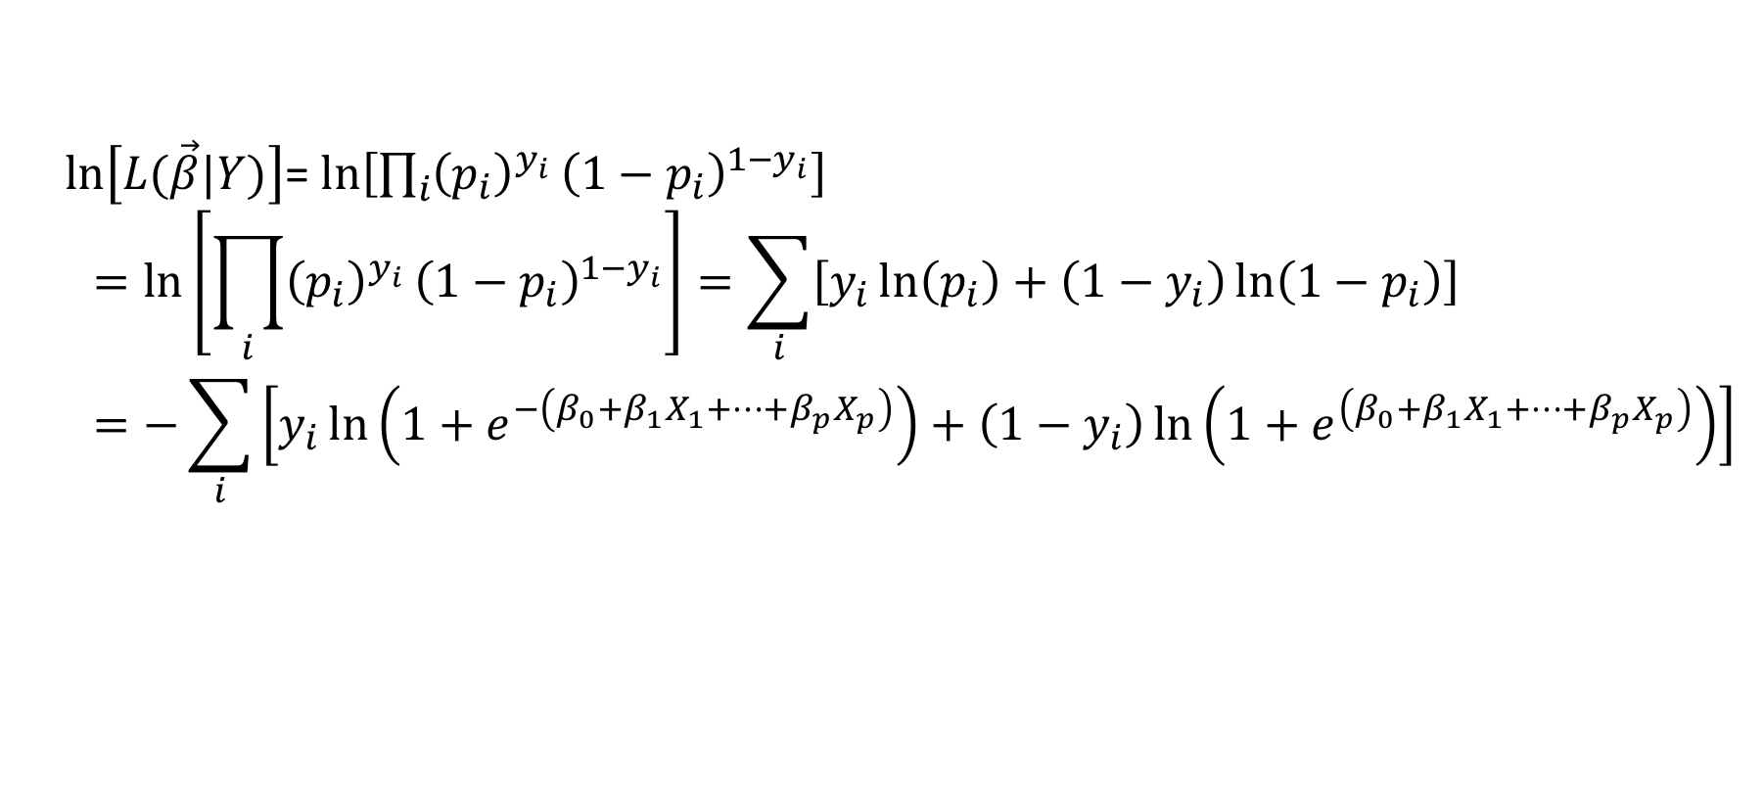
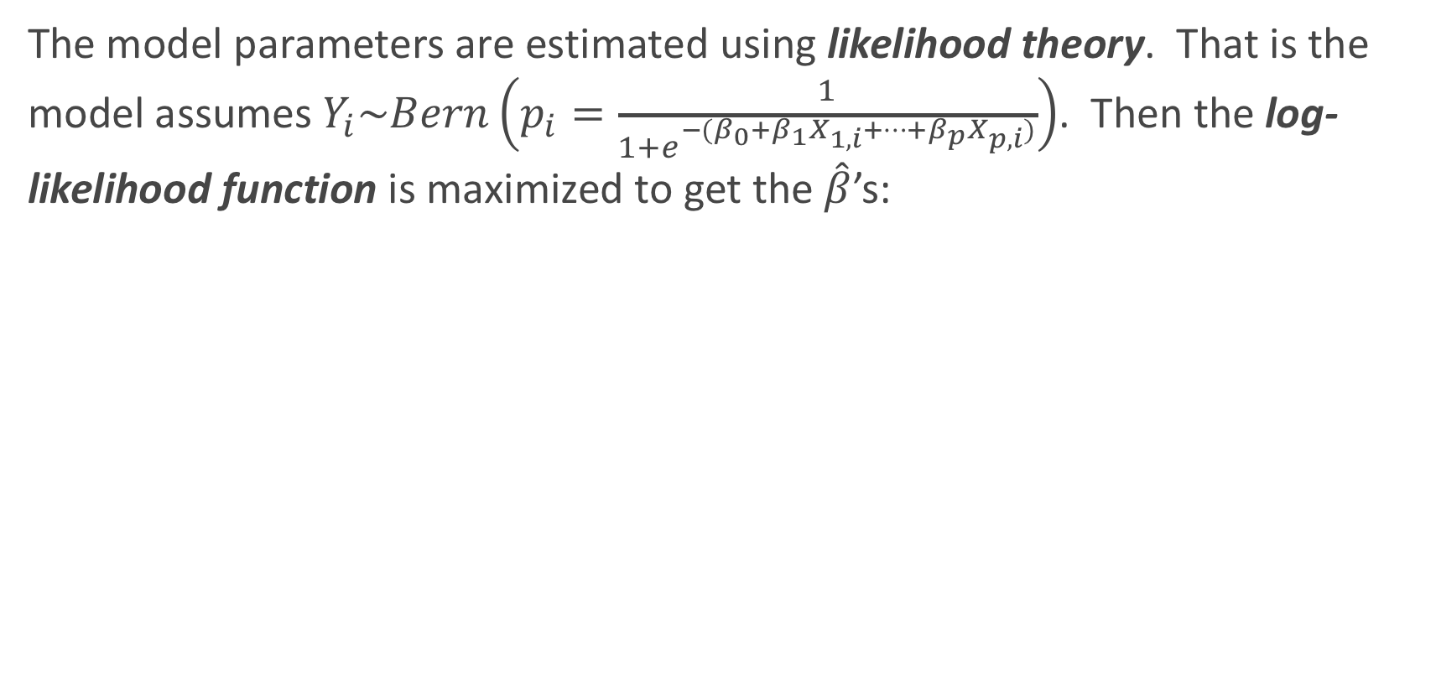
Multiple Logistic Regression: Estimation
The model parameters are estimated using likelihood theory. That is the model assumes $Y_{i}\sim Bern\left(p_{i}=\frac{1}{1+e^{−(β_{0}+β_{1}X_{1,i}+…+β_{p}X_{p,i})}}\right)$. Then the log-likelihood function is maximized to get the $\hat{β}$’s:
$\ln\left[L(\vec{β}|Y)\right]$= $\ln\left[\prod_{i}{{\left(p_{i}\right)}^{y_{i}}}{\left(1−p_{i}\right)}^{{1−y}_{i}}\right]$
$$=\ln\left[\prod_{i}{{\left(p_{i}\right)}^{y_{i}}}{\left(1−p_{i}\right)}^{{1−y}_{i}}\right]=\sum_{i}{\left[y_{i}\ln\left(p_{i}\right)+\left(1−y_{i}\right)\ln\left(1−p_{i}\right)\right]} \\ =−\sum_{i}{\left[y_{i}\ln\left(1+e^{−\left(β_{0}+β_{1}X_{1}+…+β_{p}X_{p}\right)}\right)+\left(1−y_{i}\right)\ln\left(1+e^{\left(β_{0}+β_{1}X_{1}+…+β_{p}X_{p}\right)}\right)\right]}$$

Slide 6
Classification Boundaries

Slide 7
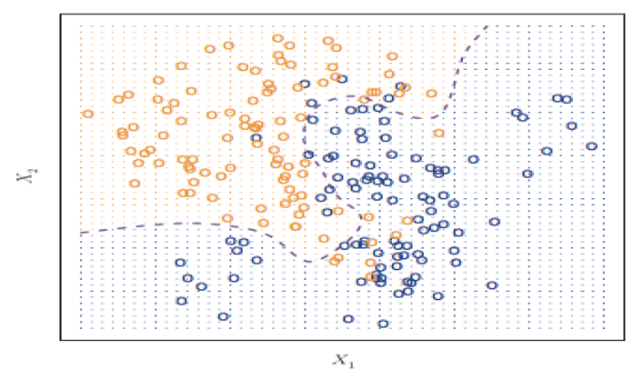
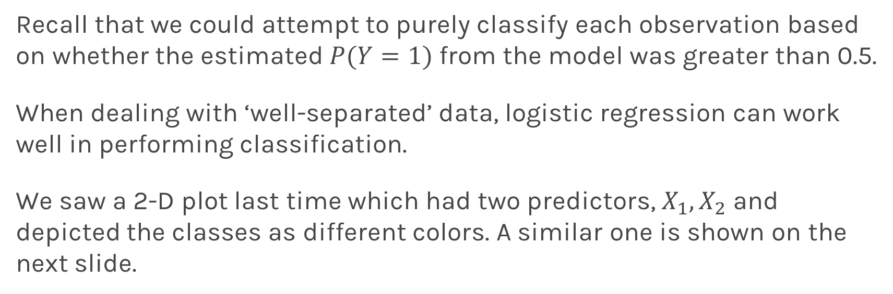
Classification boundaries
Recall that we could attempt to purely classify each observation based on whether the estimated $P(Y=1)$ from the model was greater than 0.5.
When dealing with ‘well-separated’ data, logistic regression can work well in performing classification.
We saw a 2-D plot last time which had two predictors, $X_{1},X_{2}$ and depicted the classes as different colors. A similar one is shown on the next slide.

Slide 8
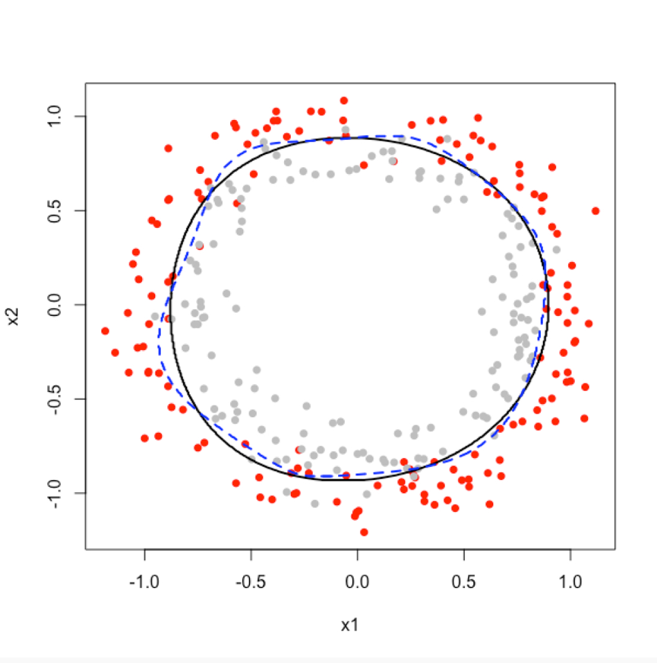
2D Classification in Logistic Regression: an Example

Slide 9
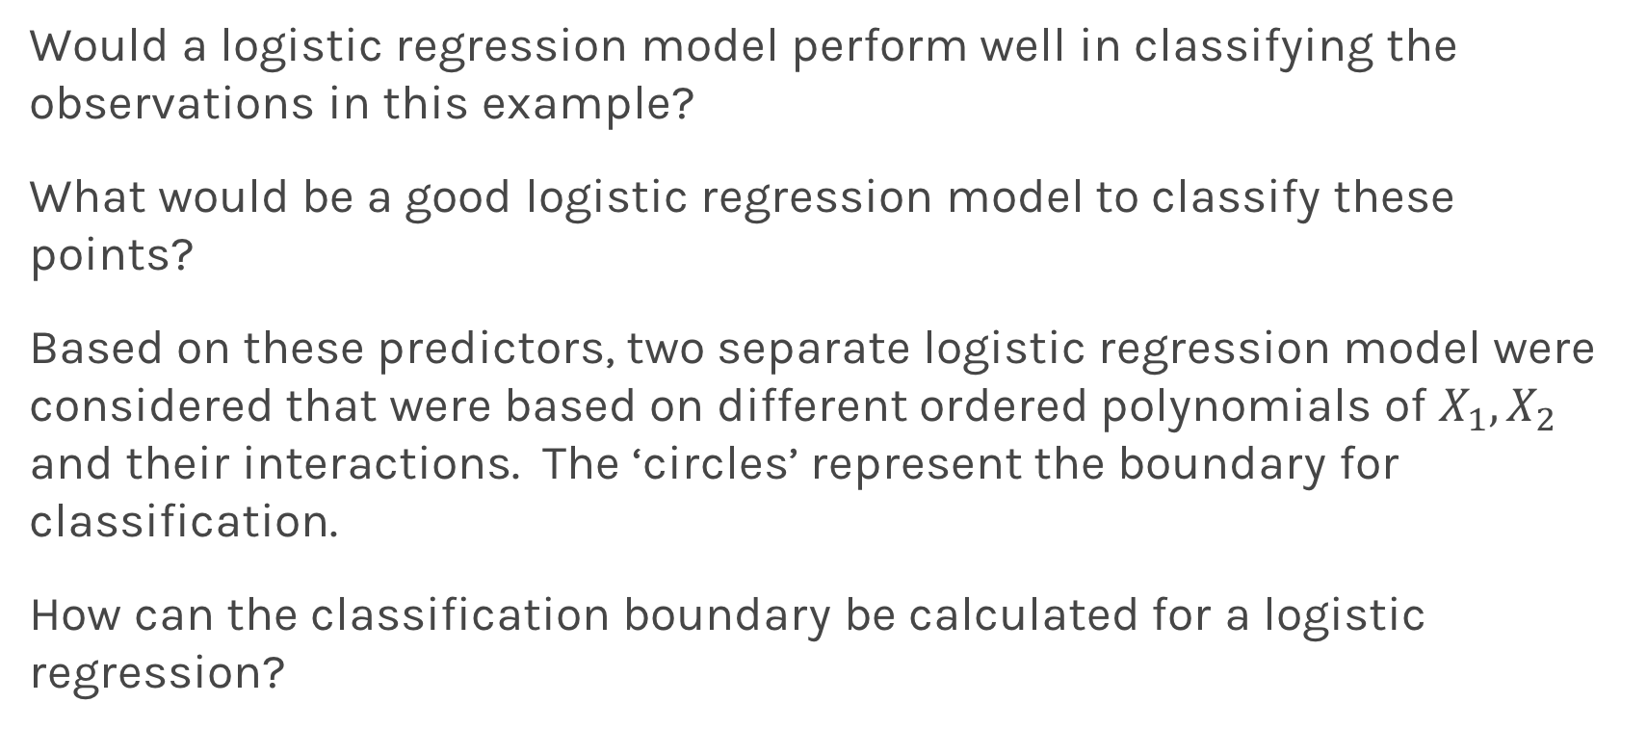
2D Classification in Logistic Regression: an Example
Would a logistic regression model perform well in classifying the observations in this example?
What would be a good logistic regression model to classify these points?
Based on these predictors, two separate logistic regression model were considered that were based on different ordered polynomials of $X_{1},X_{2}$ and their interactions. The ‘circles’ represent the boundary for classification.
How can the classification boundary be calculated for a logistic regression?

Slide 10

2D Classification in Logistic Regression: an Example
In this plot, which classification boundary performs better? How can you tell? How would you make this determination in an actual data example?
We could determine the misclassification rates in left out validation or test set(s).

Slide 11
Regularization in Logistic Regression

Slide 12
Review: Regularization in Linear Regression
Based on the Likelihood framework, a loss function can be determined based on the likelihood function.
We saw in linear regression that maximizing the log-likelihood is equivalent to minimizing the sum of squares error:

Slide 13
Review: Regularization in Linear Regression
And a regularization approach was to add a penalty factor to this equation. Which for Ridge Regression becomes:
Note: this penalty shrinks the estimates towards zero, and had the analogue of using a Normal prior centered at zero in the Bayesian paradigm.

Slide 14

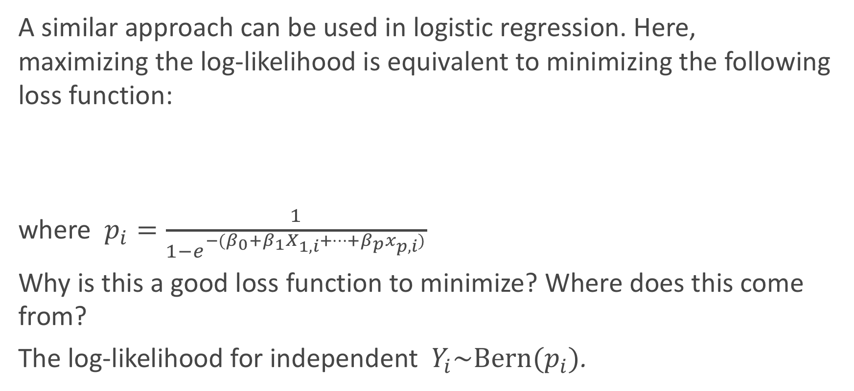
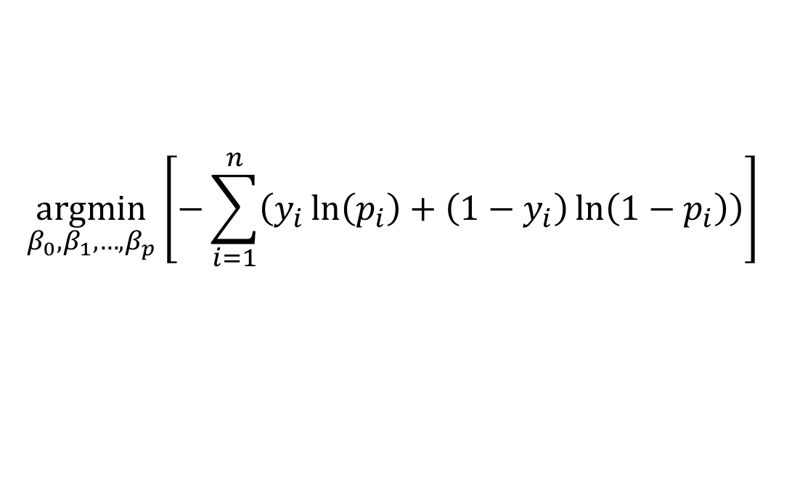
Loss function in Logistic Regression
A similar approach can be used in logistic regression. Here, maximizing the log-likelihood is equivalent to minimizing the following loss function:
where $p_{i}=\frac{1}{1−e^{−(β_{0}+β_{1}X_{1,i}+…+β_{p}x_{p,i})}}$
Why is this a good loss function to minimize? Where does this come from?
The log-likelihood for independent $Y_{i}\sim \text{Bern}(p_{i})$.
$$\underset{β_{0},β_{1},…,β_{p}}{argmin}⁡\left[−\sum_{i=1}^{n}{\left(y_{i}\ln\left(p_{i}\right)+\left(1−y_{i}\right)\ln\left(1−p_{i}\right)\right)}\right]$$

Slide 15
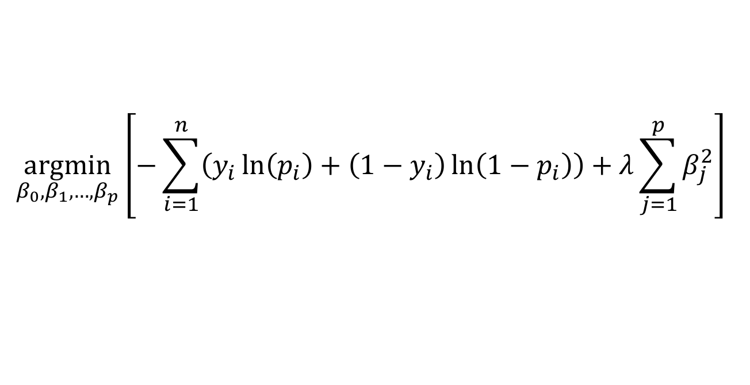
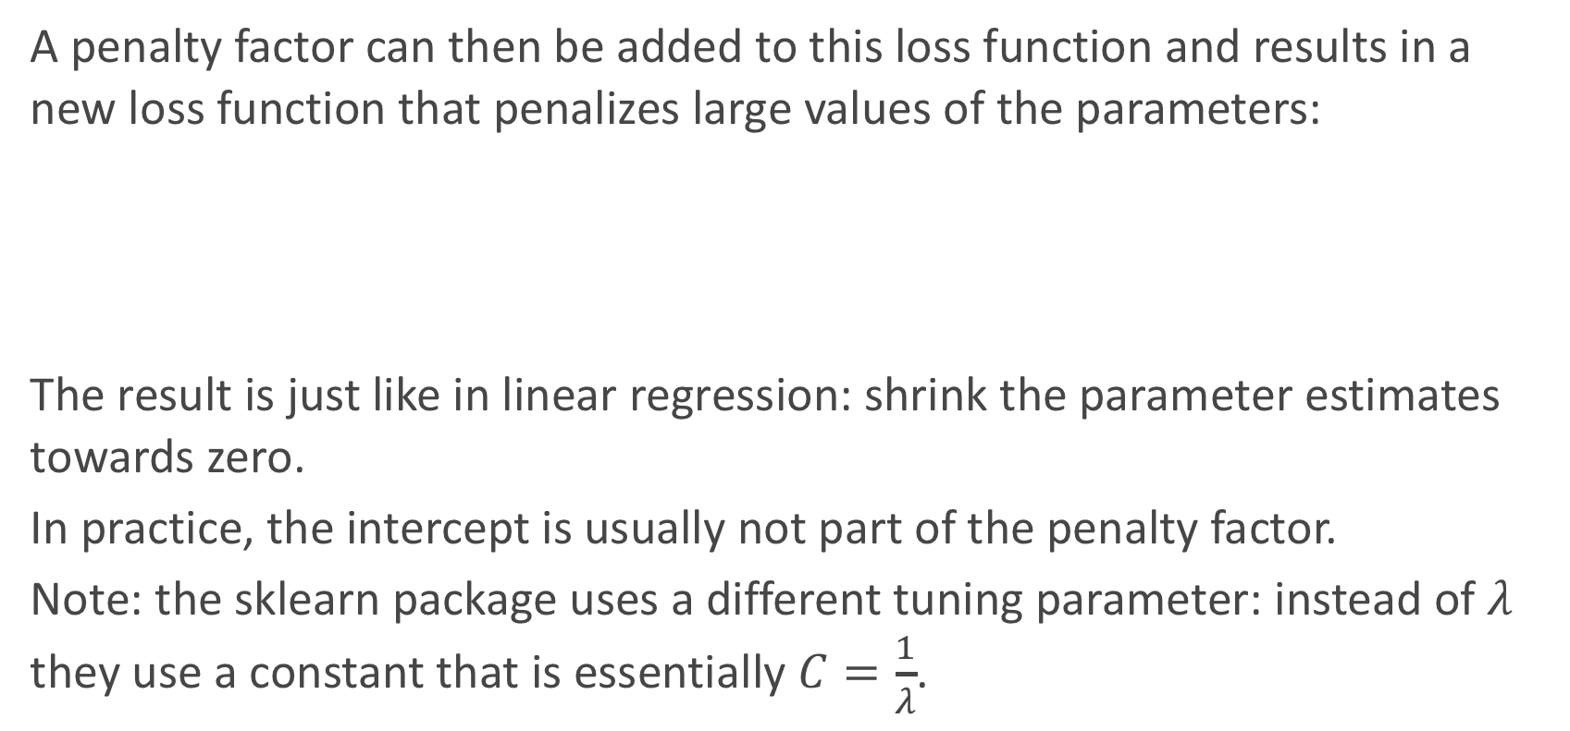
Regularization in Logistic Regression
A penalty factor can then be added to this loss function and results in a new loss function that penalizes large values of the parameters:
The result is just like in linear regression: shrink the parameter estimates towards zero.
In practice, the intercept is usually not part of the penalty factor.
Note: the sklearn package uses a different tuning parameter: instead of $λ$ they use a constant that is essentially $C=\frac{1}{λ}$.
$$\underset{β_{0},β_{1},…,β_{p}}{argmin}⁡\left[−\sum_{i=1}^{n}{\left(y_{i}\ln\left(p_{i}\right)+\left(1−y_{i}\right)\ln\left(1−p_{i}\right)\right)}+λ\sum_{j=1}^{p}{β_{j}^{2}}\right]$$

Slide 16
Regularization in Logistic Regression: an Example
Let’s see how this plays out in an example in logistic regression.

Slide 17
Regularization in Logistic Regression: an Example
Let’s see how this plays out in an example in logistic regression.

Slide 18
Regularization in Logistic Regression: tuning $λ$
Just like in linear regression, the shrinkage factor must be chosen. How should we go about doing this?
Through building multiple training and test sets (through k-fold or random subsets), we can select the best shrinkage factor to mimic out-of-sample prediction.
How could we measure how well each model fits the test sets?
We should measure this based on some loss function!

Slide 19
Regularized Decision Boundaries

Slide 20
Multinomial Logistic Regression

Slide 21
Logistic Regression for predicting more than 2 Classes
There are several extensions to standard logistic regression when the response variable Y has more than 2 categories. The two most common are:
ordinal logistic regression
multinomial logistic regression.
Ordinal logistic regression is used when the categories have a specific hierarchy (like class year: Freshman, Sophomore, Junior, Senior; or a 7-point rating scale from strongly disagree to strongly agree).
Multinomial logistic regression is used when the categories have no inherent order (like eye color: blue, green, brown, hazel, et...).

Slide 22
Multiclass Logistic Regression
There are two common approaches to estimating a nominal (not-ordinal) categorical variable that has more than 2 classes. The first approach sets one of the categories in the response variable as the reference group, and then fits separate logistic regression models to predict the other cases based off of the reference group. For example we could attempt to predict a student’s concentration:
from predictors x₁ number of psets per week and x₂ how much time spent in Lamont Library.

Slide 23
Multiclass Logistic Regression (cont.)
We could select the y = 3 case as the reference group (other concentration), and then fit two separate models: a model to predict y = 1 (CS) from y = 3 (others) and a separate model to predict y = 2 (Stat) from y = 3 (others).
Ignoring interactions, how many parameters would need to be estimated?
How could these models be used to estimate the probability of an individual falling in each concentration?

Slide 24
One vs. Rest (ovr) Logistic Regression
The default multiclass logistic regression model is called the ’One vs. Rest’ approach, which is our second method.
If there are 3 classes, then 3 separate logistic regressions are fit, where the probability of each category is predicted over the rest of the categories combined. So for the concentration example, 3 models would be fit:
a first model would be fit to predict CS from (Stat and Others) combined.
a second model would be fit to predict Stat from (CS and Others) combined.
a third model would be fit to predict Others from (CS and Stat) combined.
An example to predict ECG results from the Heart data to follow…

Slide 25
OVR Logistic Regression in Python

Slide 26
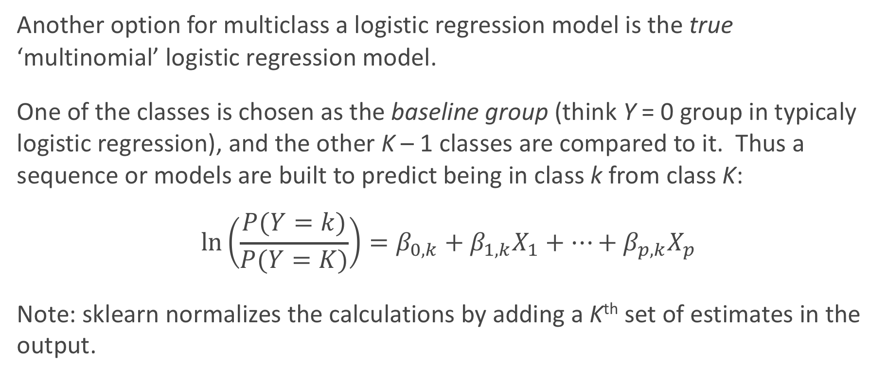
‘True’ Multinomial Logistic Regression
Another option for multiclass a logistic regression model is the true ‘multinomial’ logistic regression model.
One of the classes is chosen as the baseline group (think Y = 0 group in typicaly logistic regression), and the other K – 1 classes are compared to it. Thus a sequence or models are built to predict being in class k from class K:
$$\ln\left(\frac{P(Y=k)}{P(Y=K)}\right)=β_{0,k}+β_{1,k}X_{1}+…+β_{p,k}X_{p}$$
Note: sklearn normalizes the calculations by adding a K^{th} set of estimates in the output.

Slide 27
Multinomial Logistic Regression in Python

Slide 28
‘multinomial’ vs. ‘ovr’
There are 2 options in sklearn, so which should we use?
‘multinomial’ is slightly more efficient in estimation since there technically are fewer parameters (though sklearn reports extra ones to normalize the calculations to 1) and is more suitable for inferences/group comparisons.
‘ovr’ is often preferred for determining classification: you simply just predict from all 3 separate models (for each individual) and choose the highest probability.
They give VERY similar results in estimated probabilities and classifications.

Slide 29
Classification for more than 2 Categories
When there are more than 2 categories in the response variable, then there is no guarantee that P(Y = k) ≥ 0.5 for any one category. So any classifier based on logistic regression will instead have to select the group with the largest estimated probability.
The classification boundaries are then much more difficult to determine. We will not get into the algorithm for drawing these in this class.

Slide 30
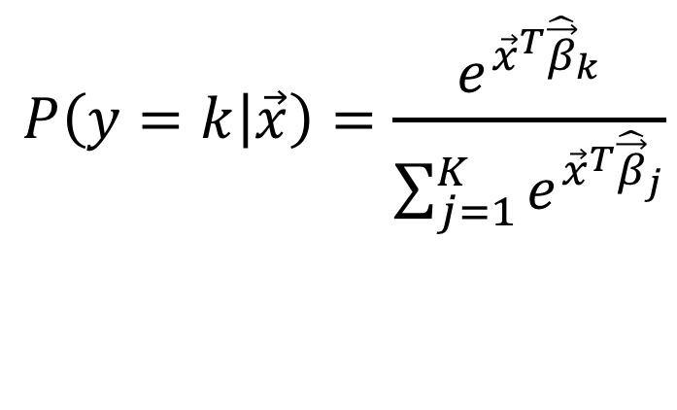
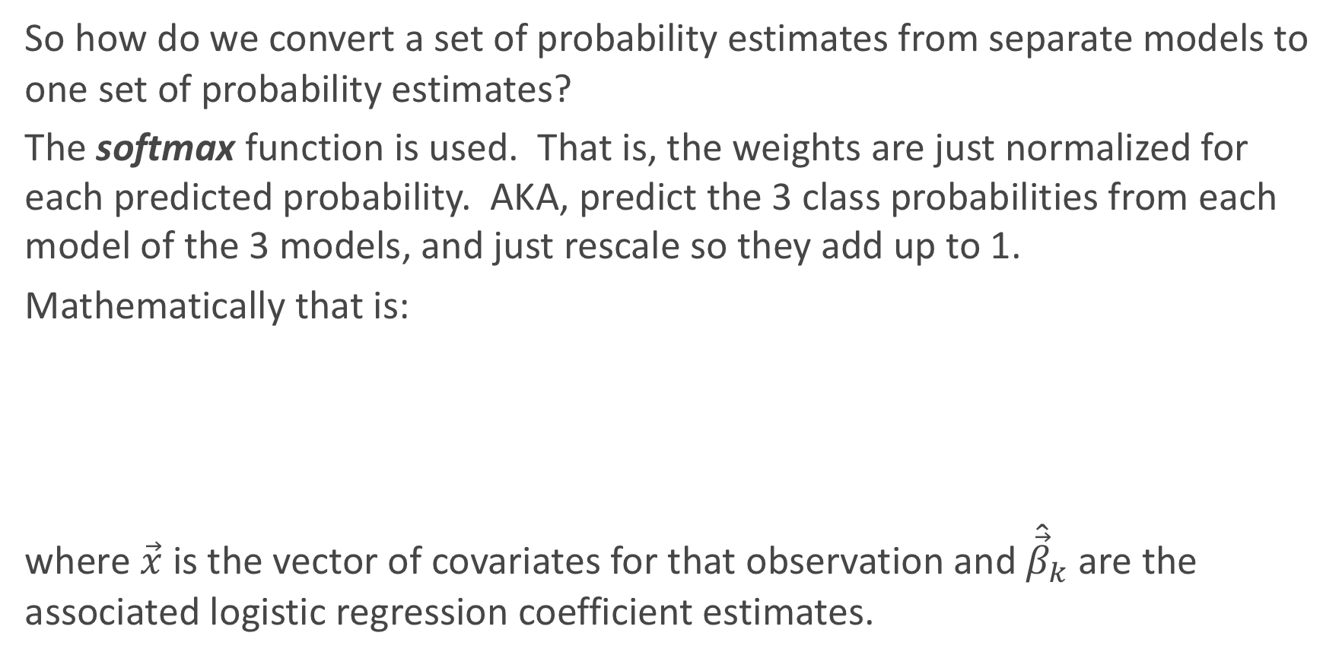
Softmax
So how do we convert a set of probability estimates from separate models to one set of probability estimates?
The softmax function is used. That is, the weights are just normalized for each predicted probability. AKA, predict the 3 class probabilities from each model of the 3 models, and just rescale so they add up to 1.
Mathematically that is:
where $\vec{x}$ is the vector of covariates for that observation and ${\hat{\vec{β}}}_{k}$are the associated logistic regression coefficient estimates.
$$P\left(y=k | \vec{x}\right)=\frac{e^{{\vec{x}}^{T}{\hat{\vec{β}}}_{k}}}{\sum_{j=1}^{K}{e^{{\vec{x}}^{T}{\hat{\vec{β}}}_{j}}}}$$

Slide 31
Classification for more than 2 Categories in sklearn

Slide 32
Bayes Theorem and Misclassification Rates

Slide 33
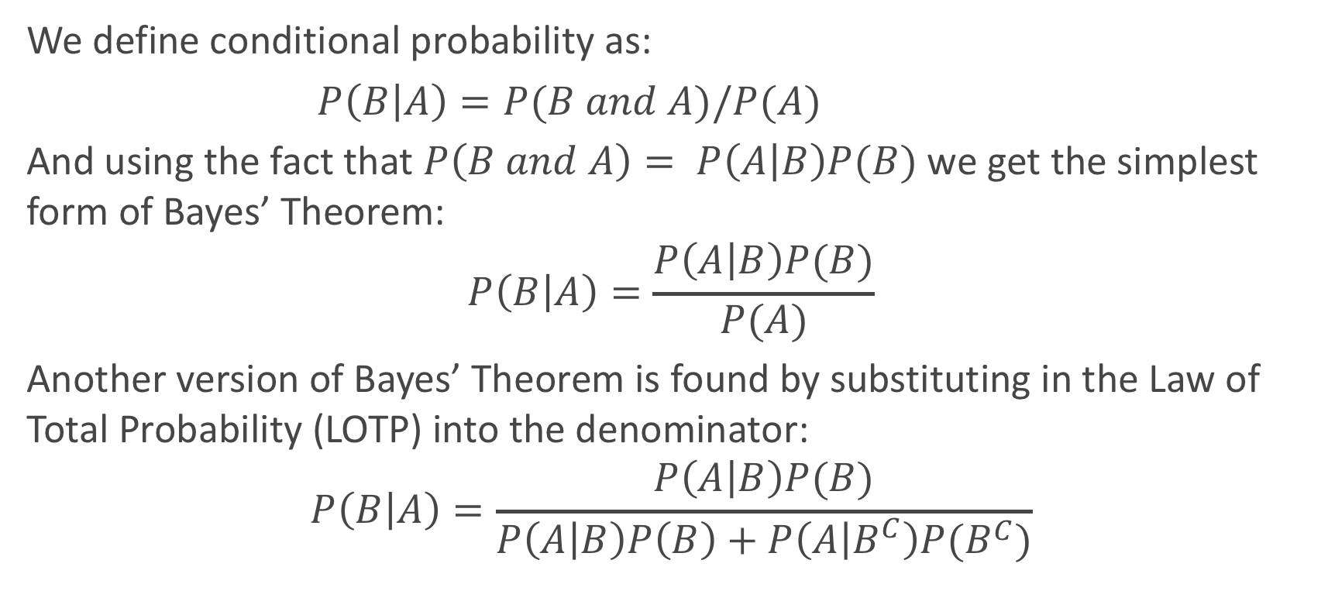
Bayes’ Theorem
We define conditional probability as:
$P\left(B | A\right)=P(B and A)/P(A)$
And using the fact that $P\left(B and A\right)= P\left(A | B\right)P(B)$we get the simplest form of Bayes’ Theorem:
$$P\left(B | A\right)=\frac{P\left(A | B\right)P(B)}{P(A)}$$
Another version of Bayes’ Theorem is found by substituting in the Law of Total Probability (LOTP) into the denominator:
$$P\left(B | A\right)=\frac{P\left(A | B\right)P(B)}{P\left(A | B\right)P\left(B\right)+P\left(A | B^{C}\right)P(B^{C})}$$

Slide 34
Diagnostic Testing
In the diagnostic testing paradigm, one cares about whether the results of a test (like a classification test) matches truth (the true class that observation belongs to). The simplest version of this is trying to detect disease (D+ vs. D−) based on a diagnostic test (T+ vs. T−).
Medical examples of this include various screening tests: breast cancer screening through (i) self-examination and (ii) mammography, prostate cancer screening through (iii) PSA tests, and Colo-rectal cancer through (iv) colonoscopies.
These tests are a little controversial because of poor predictive probability of the tests.

Slide 35
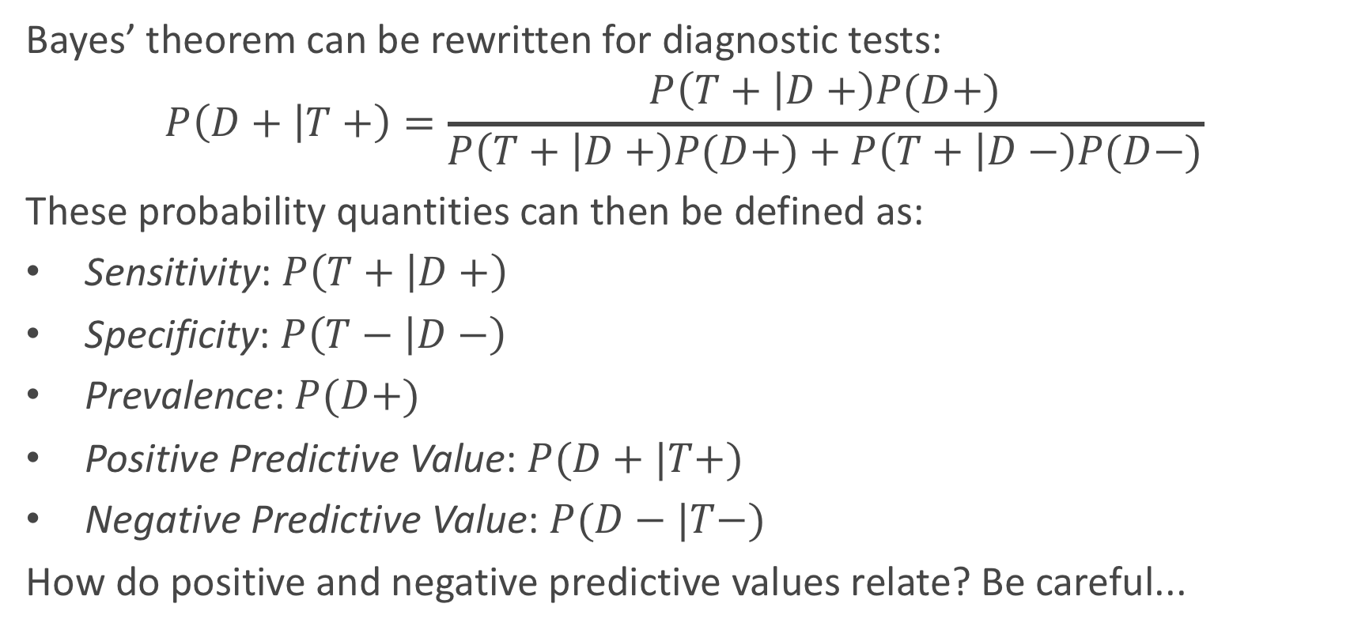
Diagnostic Testing (cont.)
Bayes’ theorem can be rewritten for diagnostic tests:
$$P\left(D+ | T+\right)=\frac{P\left(T+ | D+\right)P(D+)}{P\left(T+ | D+\right)P(D+)+P\left(T+ | D−\right)P(D−)}$$
These probability quantities can then be defined as:
Sensitivity: $P\left(T+ | D+\right)$
Specificity: $P\left(T− | D−\right)$
Prevalence: $P(D+)$
Positive Predictive Value: $P(D+|T+)$
Negative Predictive Value: $P(D−|T−)$
How do positive and negative predictive values relate? Be careful...

Slide 36
Diagnostic Testing
We mentioned that these tests are a little controversial because of their poor predictive probability. When will these tests have poor positive predictive probability?
When the disease is not very prevalent, then the number of ’false positives’ will overwhelm the number of true positive. For example, PSA screening for prostate cancer has sensitivity of about 90% and specificity of about 97% for some age groups (men in their fifties), but prevalence is about 0.1%.
What is positive predictive probability for this diagnostic test?

Slide 37
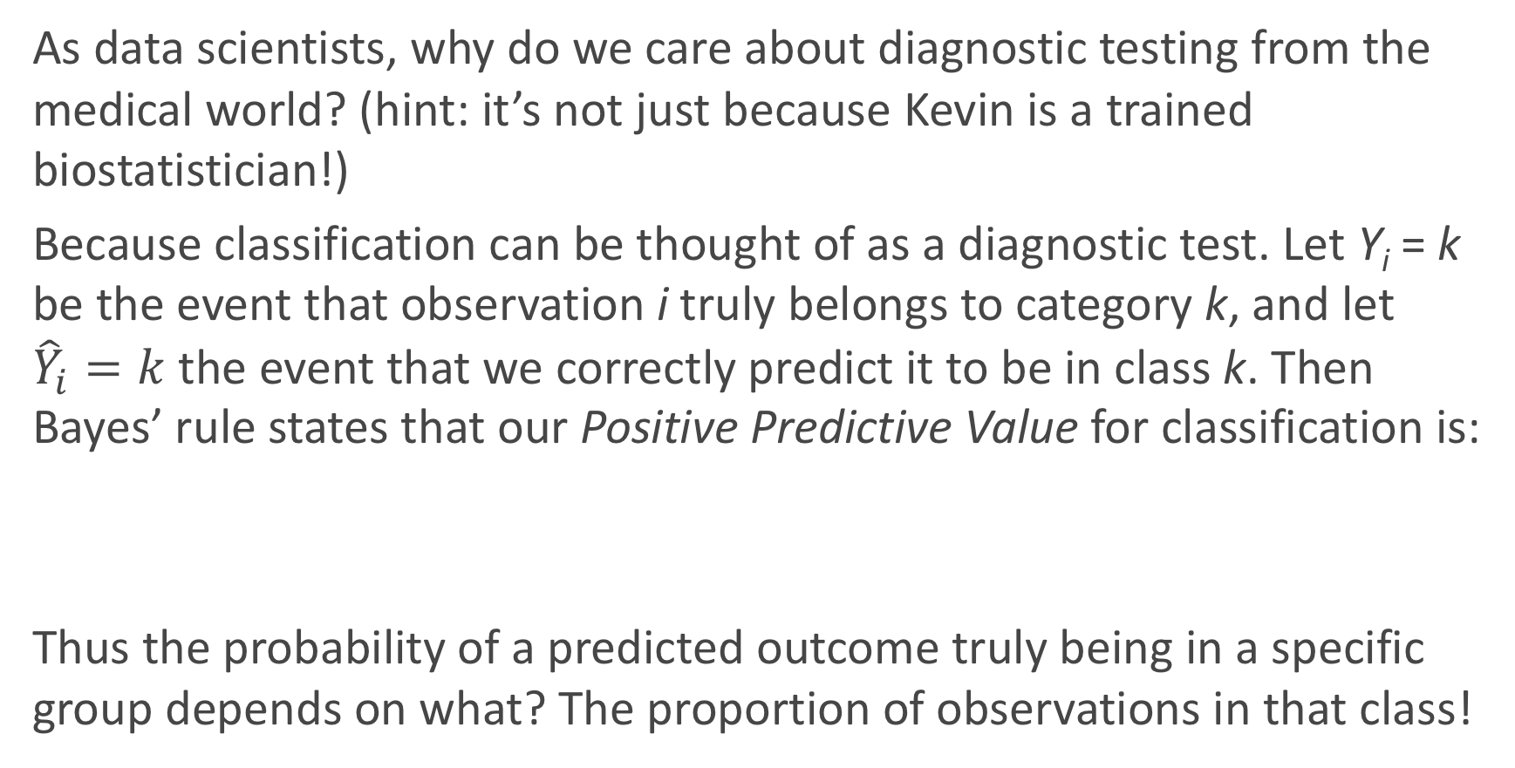
Why do we care?
As data scientists, why do we care about diagnostic testing from the medical world? (hint: it’s not just because Kevin is a trained biostatistician!)
Because classification can be thought of as a diagnostic test. Let Y_{i} = k be the event that observation i truly belongs to category k, and let ${\hat{Y}}_{i}=k$ the event that we correctly predict it to be in class k. Then Bayes’ rule states that our Positive Predictive Value for classification is:
Thus the probability of a predicted outcome truly being in a specific group depends on what? The proportion of observations in that class!

Slide 38
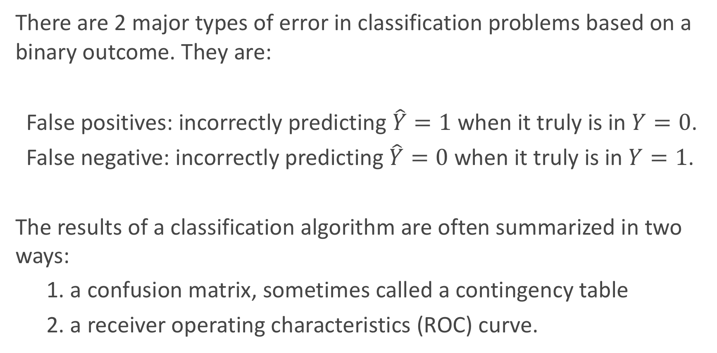
Error in Classification
There are 2 major types of error in classification problems based on a binary outcome. They are:
False positives: incorrectly predicting $\hat{Y}=1$ when it truly is in $Y=0$.
False negative: incorrectly predicting$\hat{Y}=0$ when it truly is in $Y=1$.
The results of a classification algorithm are often summarized in two ways:
1. a confusion matrix, sometimes called a contingency table
2. a receiver operating characteristics (ROC) curve.

Slide 39
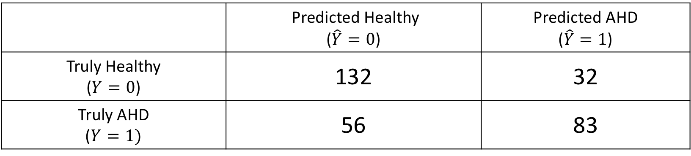
Confusion table
When a classification algorithm (like logistic regression) is used, the results can be summarize in a (2 x 2) table as such:
The table above was a classification based on a logistic regression model to predict heart disease based on 3 predictors: X₁ = Sex, X₂ = Resting HR, and X₃ = the interaction between the two.
What are the false positive and false negative rates for this classifier?
 | Predicted Healthy ($\hat{Y}=0$) | Predicted AHD ($\hat{Y}=1$)
Truly Healthy ($Y=0$) | 132 | 32
Truly AHD ($Y=1)$ | 56 | 83

Slide 40
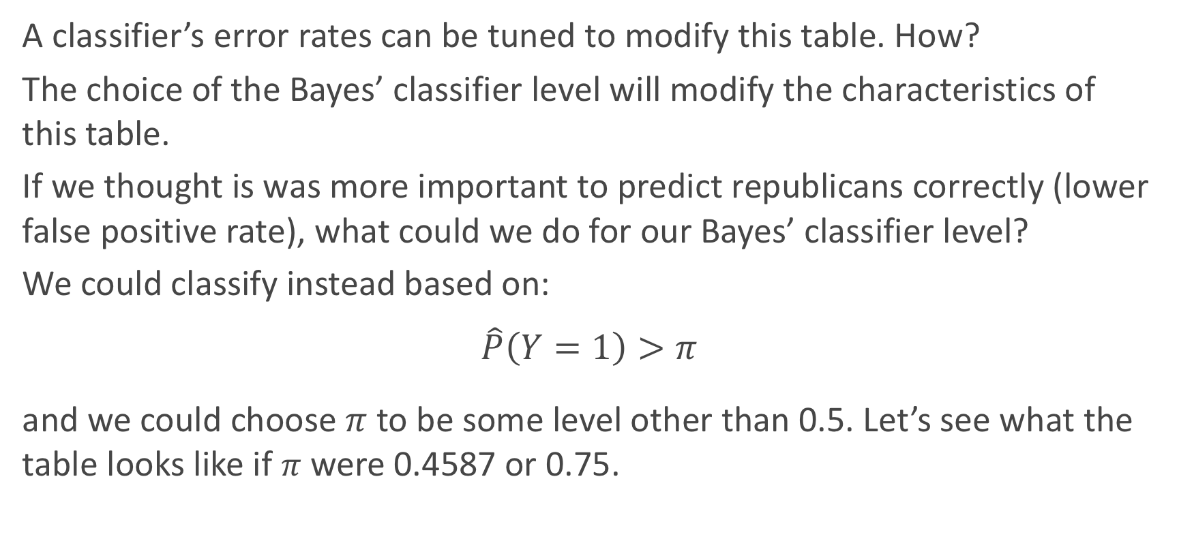
Bayes’ Classifier Choice
A classifier’s error rates can be tuned to modify this table. How?
The choice of the Bayes’ classifier level will modify the characteristics of this table.
If we thought is was more important to predict republicans correctly (lower false positive rate), what could we do for our Bayes’ classifier level?
We could classify instead based on:
$$\hat{P}\left(Y=1\right)>π$$
and we could choose $π$ to be some level other than 0.5. Let’s see what the table looks like if $π$ were 0.4587 or 0.75.

Slide 41
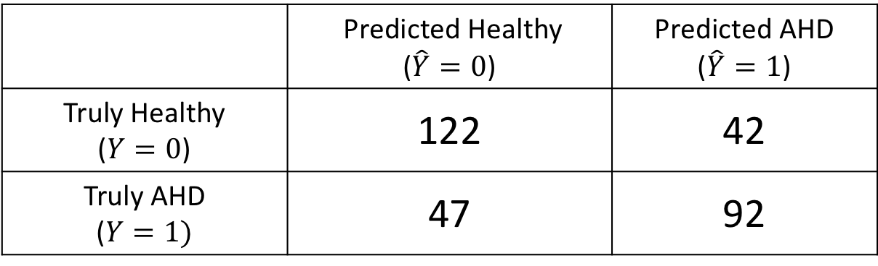
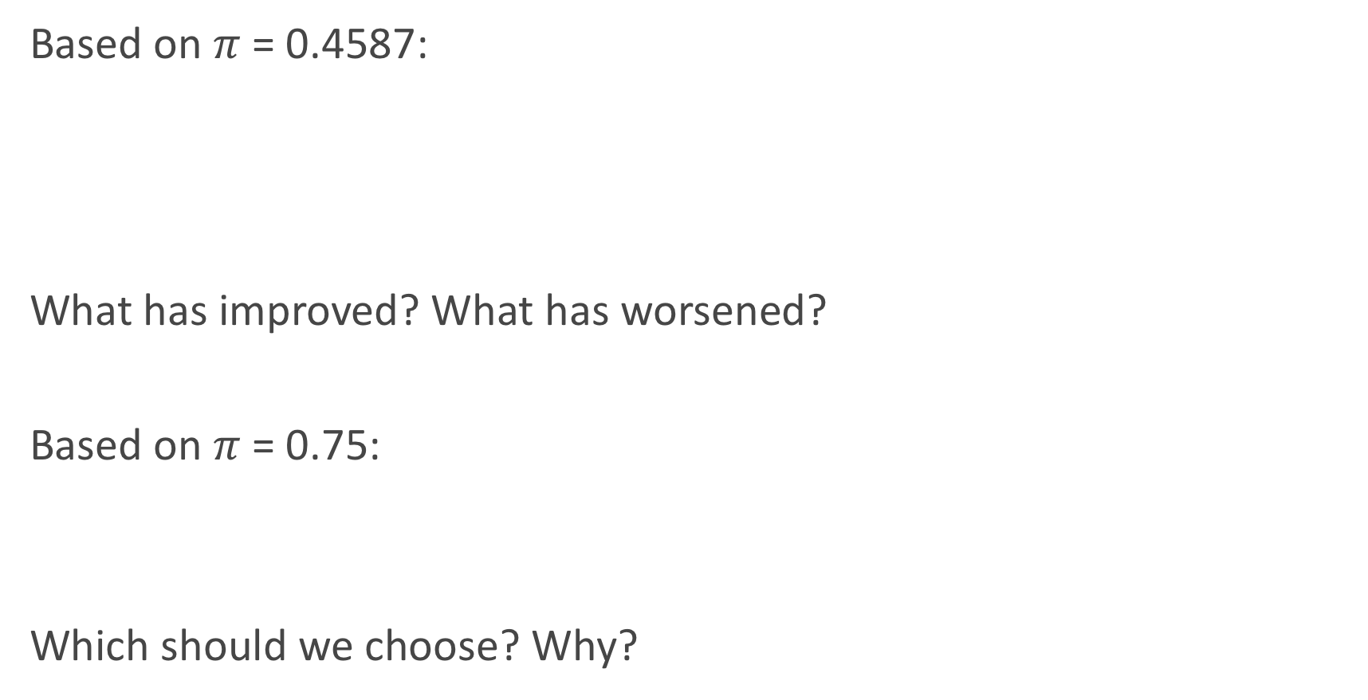
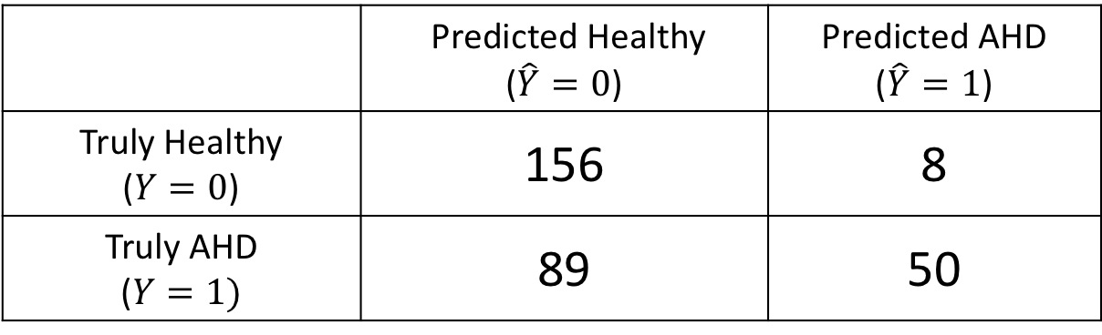
Other Confusion tables
 | Predicted Healthy ($\hat{Y}=0$) | Predicted AHD ($\hat{Y}=1$)
Truly Healthy ($Y=0$) | 122 | 42
Truly AHD ($Y=1)$ | 47 | 92
Based on $π$ = 0.4587:
What has improved? What has worsened?
Based on $π$ = 0.75:
Which should we choose? Why?
 | Predicted Healthy ($\hat{Y}=0$) | Predicted AHD ($\hat{Y}=1$)
Truly Healthy ($Y=0$) | 156 | 8
Truly AHD ($Y=1)$ | 89 | 50

Slide 42
ROC Curves

Slide 43
ROC Curves
The Radio Operator Characteristics (ROC) curve illustrates the trade-off for all possible thresholds chosen for the two types of error (or correct classification).
The vertical axis displays the true positive rate and the horizontal axis depicts the false positive rate.
What is the shape of an ideal ROC curve?
See next slide for an example.

Slide 44
ROC Curve Example

Slide 45
ROC Curve for measuring classifier preformance
The overall performance of a classifier, calculated over all possible thresholds, is given by the area under the ROC curve (’AUC’).
An ideal ROC curve will hug the top left corner, so the larger the AUC the better the classifier.
What is the worst case scenario for AUC? What is the best case? What is AUC if we independently just flip a coin to perform classification?
This AUC then can be use to compare various approaches to classification: Logistic regression, LDA (to come), k-NN, etc...

